Slide 1
ECE 497 · UNIT 4
Evolving a body's brain
Neuroevolution of a Braitenberg vehicle, closing the loop
Recap vehicle, evolutionary algorithm, network
Focus how they connect: genotype → network → body → fitness
Then the official PyTorch + EvoTorch version (Project 4)
PythonBasics/Unit4 · env.py · fnn.py · eas.py · evolve.py · sim.py · viz.py
Notes:
Frame the day: the pieces are old, the wiring between them is new. Recaps are about a minute each. Most time goes on slides 7-14 plus the live demo. The last two slides show how the same pipeline looks in the official PyTorch/EvoTorch project.

Slide 2
OVERVIEW
Three pieces you already have
ENV.PY
EAS.PY
FNN.PY
EVOLVE.PY
Braitenberg vehicle
Evolutionary algorithm
Feedforward network
An evolved steering brain
+
+
A body with two light sensors and two motors, plus a light at the origin.
Same as Unit 3. Needs only a fitness number per genotype.
Same as Unit 3. Genotype vector in, weights and biases out.
Fitness comes from behavior in the world, not a fixed dataset.
Today's question: what has to connect so that a genotype from the GA can drive a body, and the body's behavior can score the genotype?
PythonBasics/Unit4/README.md
Notes:
Nothing algorithmically new today. fnn.py and eas.py are the same files as Unit 3. env.py is the Project 1 vehicle rewritten in plain Python. evolve.py is the new glue.

Slide 3
RECAP · THE BODY
The vehicle: sense, think, move
sense()
think()
move()
# env.py: Braitenberg (trimmed)
def sense(self, light):
self.sensors[0] = 1/(1 + gain * left_dist)
self.sensors[1] = 1/(1 + gain * right_dist)
def think(self):
self.motors = self.controller.forward(self.sensors)[0]
def move(self):
self.orientation += turngain*(m[1]-m[0]) + noise
self.velocity = velgain*(m[0]+m[1])/2
each sensor reads 1 / (1 + gain × distance to light)
→
two sensor values become two motor values
→
motor difference turns, motor average drives
Light at the origin. Start on a random point 5 units away, random heading.
Turn = turngain × (right − left) + noise.
Speed = velgain × mean(left, right).
The brain is whatever object sits in self.controller.
PythonBasics/Unit4/env.py
Notes:
Brief. The light sits at the origin and the vehicle starts on a circle of radius 5 around it, random heading. Point out that think() is one line: the whole brain is the controller object. Code is trimmed from env.py.

Slide 4
RECAP · THE ALGORITHM
The evolutionary algorithm: one tournament
1
2
3
4
5
Pick two
→
Compare
→
Transfect
→
Mutate
→
Re-score
Random a, and a neighbor b within a deme of 5
The higher fitness is the winner
Loser takes each gene from the winner with prob. 0.5
Add Gaussian noise (std 0.05), clip to [−1, 1]
Only the loser gets a new fitness evaluation
50
50
0.5
0.05
5
popsize
generations
recombProb
mutatStd
demeSize
The GA's whole view of the problem: a vector of 32 numbers in [−1, 1] goes in, one fitness number comes out.
PythonBasics/Unit4/eas.py · Microbial · settings from evolve.py
Notes:
This is eas.Microbial, the same file as Unit 3. Each tournament changes one individual. A generation is popsize tournaments, so 50 generations is 2,500 tournaments and 2,500 fitness evaluations. Point out that only the loser is re-scored.

Slide 5
RECAP · THE BRAIN
The network: 2 sensors in, 2 motors out
THE GENOTYPE: ONE FLAT VECTOR
16
6
10
weights
biases
activation genes
= 32 numbers
weightrange = 5. Genes stay in [−1, 1]; setParams scales them so weights and biases are in [−5, 5].
Two outputs, one per motor.
Activation genes: 5 per layer. The largest picks that layer's function: sigmoid, tanh, relu, linear or gaussian.
Input
left, right sensor
Hidden
4 units
Output
left, right motor
PythonBasics/Unit4/fnn.py · setParams() · layers = [2, 4, 2]
Notes:
fnn.py setParams slices the genotype: weights, then biases, then activation genes. Genes in [-1,1] are multiplied by weightrange=5. Genome size is 16 weights + 6 biases + 10 activation genes = 32. For each layer, the argmax of its 5 activation genes picks sigmoid, tanh, relu, linear or gaussian, so the network evolves its own activation functions. Output activations are not forced to be bounded.

Slide 6
HOW THEY CONNECT
What if fitness is not a lookup, but a life?
Every genotype gets a body, a random start, and 200 steps to show what it can do.
Notes:
Transition. Everything before this was review.

Slide 7
CONNECTION 1 · BRAIN ↔ BODY
The body is handed its brain
INSIDE THE BODY · env.py
WHERE IT'S ASSEMBLED · evolve.py
class Braitenberg:
def __init__(self, neuralnetwork, distance):
self.controller = neuralnetwork
def think(self):
self.motors = self.controller.forward(
self.sensors)[0]
controller = fnn.FNN(layers)
controller.setParams(genotype)
agent = env.Braitenberg(controller, distance)
light = env.Light()
Same interface: any object with forward([left, right]) that returns two motor values can drive the body.
Loose coupling: env.py knows nothing about evolution, and eas.py knows nothing about vehicles.
Only setParams connects a genotype to behavior: the same vector becomes different weights, so a different vehicle.
PythonBasics/Unit4/env.py · evolve.py · fitnessFunction()
Notes:
env.py does not import fnn or eas. Braitenberg just stores whatever it is given as self.controller and calls .forward(). Live demo idea: show env.py's imports, then jump to the three lines in fitnessFunction.

Slide 8
CONNECTION 2 · CLOSED LOOP
The network's output changes its own input
Sense
Think
Move
New pose
left_sensor
right_sensor
FNN [2, 4, 2]
controller.forward
left_motor
right_motor
x, y,
orientation
repeated 200 times per trial: the new pose gives new sensor readings
Not like XOR
Behavior is a loop
Evolution's view
There, inputs were fixed and independent. Here, every output changes the next input.
Steering emerges from network, body and world together. No layer alone "knows" the strategy.
It sees none of this. It only receives one fitness number per genome.
PythonBasics/Unit4/env.py · sense → think → move
Notes:
Key conceptual difference from XOR: in XOR each input is independent of what the network output last time. Here the motor command moves the body, which changes what the sensors read next. The network is only a part of the behavior; the body and world are the rest. Nobody tells the network how to steer.

Slide 9
CONNECTION 2 · FITNESS
What changes when fitness comes from a body
 | Unit 3: classification | Unit 4: Braitenberg
Fitness is | score of the network on a fixed dataset | how close the body stays to the light, over 200 steps
One evaluation | a few forward passes | 4 trials × 200 steps = 800 network calls
Same genotype twice | same score, deterministic | different score: random start, heading, noise
Best possible score | perfect score is reachable | 1.0 needs to start on the light; never moving scores 0.17
Fitness inputs | data the network is shown | data the network's own outputs help create
Unchanged: fnn.py and eas.py. Only the fitness function is new, and it contains the whole simulation.
PythonBasics/Unit4/evolve.py · fitnessFunction()
Notes:
Walk the rows. The GA and the network code are untouched. What changes is the cost, the noise, and the meaning of the number.

Slide 10
CONNECTION 3 · THE FITNESS FUNCTION
Everything meets in fitnessFunction
def fitnessFunction(genotype):
controller = fnn.FNN(layers) # 1
controller.weightrange = weightrange
controller.biasrange = weightrange
controller.setParams(genotype)
fitness = 0.0
for r in range(reps): # 2
agent = env.Braitenberg(controller, distance)
light = env.Light()
for t in range(duration): # 3
agent.sense(light)
agent.think()
agent.move()
fitness += 1/(1 + agent.distance(light)) # 4
return fitness/(reps*duration)
Genotype → network
1
setParams turns 32 numbers into weights and biases.
Fresh random body
2
New start position and heading each trial.
Closed loop
3
Sense, think, move, 200 times.
Reward every step
4
1 / (1 + distance), averaged over steps and trials.
PythonBasics/Unit4/evolve.py · duration 200 · distance 5 · reps 4
Notes:
This is the slide to keep open while showing evolve.py. Four numbered steps: build the network from the genotype, make a fresh random body, run the closed loop, accumulate the reward. Note that the network never sees the fitness and the fitness never looks inside the network.

Slide 11
CONNECTION 4 · THE DATA FLOW
From a vector of numbers to a single number
genotype
FNN
Braitenberg
trajectory
fitness
32 floats in [−1, 1]
weights and biases, after setParams
body plus this brain, random start
200 positions and distances
one float, mean of 1 / (1 + d)
THREE NESTED LOOPS
50 × 50
× 4
× 200
generations × tournaments
trials per evaluation
time steps per trial
each tournament scores one new individual: 2,500 evaluations
fresh random start each time
sense, think, move
About 2 million sense-think-move steps, in plain Python, in roughly 13 seconds.
evolve.py · fitnessFunction() · eas.py · Microbial.run()
Notes:
Top row: what each stage hands to the next. Bottom: the three nested loops explain the runtime. 50 generations of 50 tournaments is 2,500 evaluations, plus 50 for the initial population, each 4 trials of 200 steps, about 2 million sense-think-move steps, about 13 seconds on a laptop.

Slide 12
CONNECTION 5 · THE CONTRACT
What the pieces share, and how they hand off
SHARED, SO THEY AGREE
from config import duration, distance, layers, weightrange
genesize = fnn.FNN.genome_size(layers)
ga = ea.Microbial(fitnessFunction, genesize, generations,
popsize=popsize, recombProb=recombProb,
mutatStd=mutatStd, demeSize=demeSize,
eliteprop=eliteprop)
ga.run()
avgfit, bestfit, bestind = ga.fitStats()
np.save("best.npy", bestind)
config.py: duration, distance, layers, weightrange, imported by evolve.py and sim.py.
FNN.genome_size(layers): genesize always matches setParams.
Only in evolve.py: reps, finaltrials, seed, and the GA settings.
evolve.py
best.npy
sim.py
sim.npz
viz.py
Three scripts, connected only by the files they save and load.
PythonBasics/Unit4/evolve.py · sim.py · viz.py
Notes:
The GA only sees a function from vector to number. Settings both scripts need (duration, distance, layers, weightrange) live in config.py, so evolve.py and sim.py cannot drift apart. FNN.genome_size computes genesize from the same layout setParams uses. Files carry results from one script to the next.

Slide 13
CONNECTION 6 · WHAT THE NUMBER MEANS
Reading the fitness number
# the reward, every time step
fitness += 1/(1 + agent.distance(light))
return fitness/(reps*duration)
Bounded in (0, 1]. 1.0 would need to start on top of the light.
Travel time costs points: the vehicle starts 5 away, so the early steps score low even for a perfect driver.
Not moving already scores 0.17, and a random network scores about the same.
Eight seeds of evolve.py gave 0.77 to 0.86.
one seeded run of evolve.py · evolved = 200 fresh single trials · random = mean of 150 genomes
Notes:
Numbers are from one seeded run (np.random.seed(3)); eight seeds gave 0.77 to 0.86. Never moves: 1/(1+5) = 0.167. Random genomes averaged over 150 draws: 0.18. Evolved: 0.81 on 200 fresh single trials. Your run will differ. Motor outputs are not bounded in this version, so there is no fixed speed limit.

Slide 14
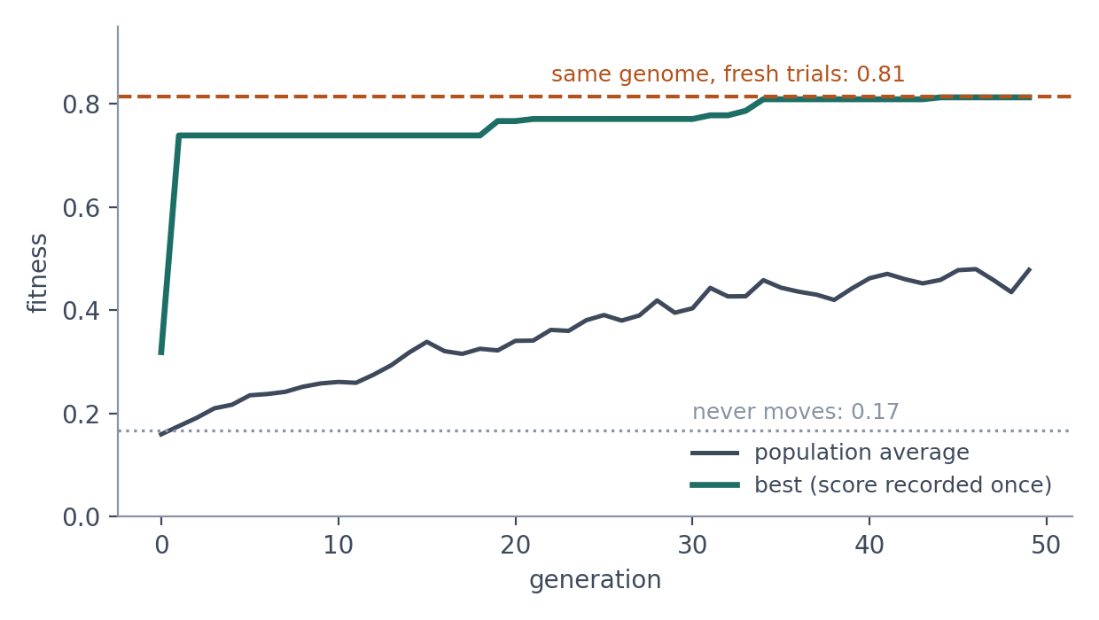
CONNECTION 7 · NOISY FITNESS
Can we trust the recorded fitness?
One sample. Each score is the mean of only 4 random trials.
Never refreshed. Microbial re-scores only the loser, so the best curve can only go up.
So check it: evolve.py now re-scores the best genotype on 100 fresh trials (dashed line).
It held up here.
Over 8 seeds, recorded and fresh fitness differ by at most 0.02. Trial-to-trial spread is under 0.01. Try reps = 1 or fewer generations: does the gap grow?
seed 3 · dashed line: 200 fresh single trials · 8 seeds compared: recorded 0.77 to 0.84, fresh 0.77 to 0.86
Notes:
Microbial computes a fitness once, when an individual is created or changed, and never re-scores it. Random starts and noise make that score a sample, and selection can favor lucky samples, so the best curve never goes down and could overstate. Here it did not: over eight seeds the recorded and fresh fitness differ by at most 0.02, because the evolved controller works from every start. The check is cheap, so always do it. In the official EvoTorch version parents are re-scored every generation.

Slide 15
DEMO
Run it: evolve, test, plot
WHAT TO WATCH
cd PythonBasics/Unit4
# 1. evolve (about 15 s): prints recorded and fresh fitness
python3 evolve.py
# 2. test best.npy on 20 new trials: saves sim.npz
python3 sim.py
# 3. trajectories and distance over time
python3 viz.py
Recorded vs fresh-trial fitness (printed)
Average fitness starts near 0.17 and climbs
Best jumps early, then only goes up
sim.py's fitness vs the one evolve.py printed
Do all trajectories reach the light?
THEN CHANGE ONE THING
Task: duration, distance (config.py), reps. Network: layers, weightrange (config.py). Algorithm: popsize, generations, mutatStd, or swap ea.Microbial for another class in eas.py.
PythonBasics/Unit4/README.md
Notes:
Run evolve.py live (about 15 seconds). While it runs walk through evolve.py. Then sim.py and viz.py. Encourage students to change one parameter and rerun.

Slide 16
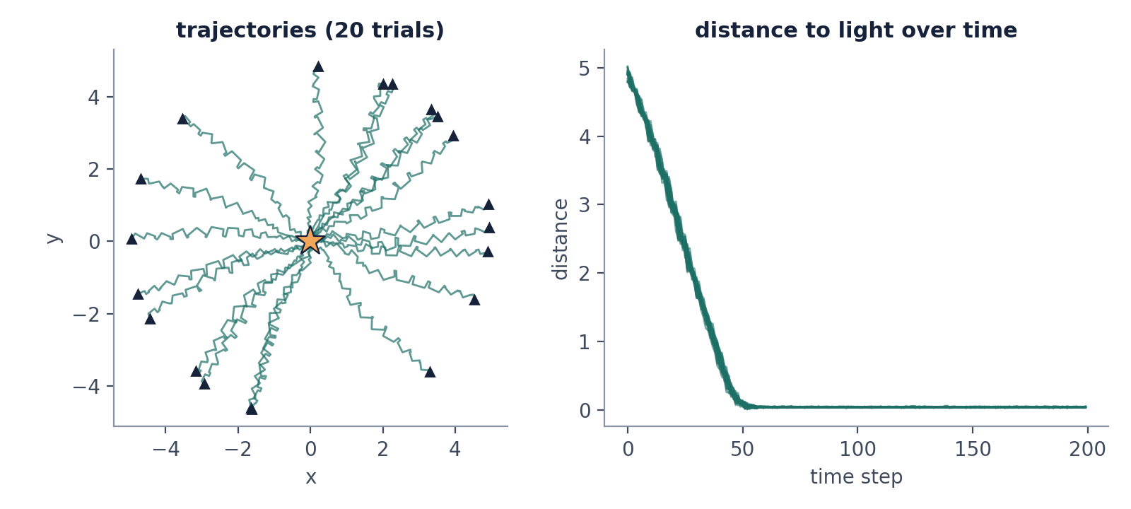
WHAT EVOLUTION FOUND
Every start reaches the light
20 of 20 trials arrive by step 40 and stay at the light.
Nearly straight paths, jittered by motion noise.
300 more fresh trials: all arrive.
Discuss
Fitness is 0.81, so what limits it now? Why do the paths all look alike? Would it still work from distance 10, or with duration 100?
PythonBasics/Unit4 · sim.py + viz.py · seed 3
Notes:
Figure comes from sim.py and viz.py on the seeded run (seed 3, fitness 0.81). All 20 trials are within distance 1 of the light by step 40 and stay there; 300 more fresh trials also all arrive. Ask what limits fitness now (travel time), why all trajectories look alike, and what changes at a larger distance or shorter duration.

Slide 17
PROJECT 4 · THE OFFICIAL VERSION
Same pipeline in PyTorch and EvoTorch
 | Unit 4 demo (plain Python) | Project 4 (PyTorch + EvoTorch)
Network | fnn.FNN, NumPy, [2, 4, 2], genes × 5 | NeuralController (nn.Module), 2 → 8 → 2, Tanh outputs in [−1, 1], 42 weights
Algorithm | eas.Microbial, one tournament at a time | EvoTorch GeneticAlgorithm: SBX crossover, Gaussian mutation, elitism
Simulation | one vehicle at a time, Python loops | simulate_population: all vehicles as tensors, about 30× faster
Task | 4 trials, 200 steps, start 5 away | 5 episodes, 2000 steps, start 10 away
Scoring | recorded once, never refreshed | parents re-scored every generation; best re-evaluated on 100 new episodes
Baseline | none | hand-wired crossed vehicle in the same code (about 0.2)
Checkpoint Fri Oct 2, in class (Parts 1 and 2). Final Tue Oct 6, before class (Part 3 and report).
4_EN_Braitenberg · neural_controller.py · braitenberg.py · evolve.py
Notes:
Project 4 lives in 4_EN_Braitenberg. Same idea, industrial tooling. The two differences students should remember: the whole population is simulated as tensors, and parents are re-scored every generation, so the best curve can go down. Checkpoint Friday Oct 2 (Parts 1 and 2), final Tuesday Oct 6.

Slide 18
PROJECT 4 · THE OFFICIAL VERSION
Same pipeline, but a whole population at once
genomes
simulate_population
dist
reward
fitness
from EvoTorch
2000 steps, all vehicles at once
distance to light after every step
1 / (1 + dist)
.mean over episodes and steps
(50, 42)
(50, 5, 2000)
(50, 5, 2000)
(50,)
shape at each stage: (pop, episodes, steps)
INSIDE ONE STEP OF simulate_population
sensors
(50, 5, 2)
motors
(50, 5, 2)
state
x, y, heading
computed from x, y, orientation
returned by the think function
advanced by move + noise
Each individual drives 5 vehicles, and all 250 advance together.
evolve.py · fitness_fn() · braitenberg.py · simulate_population()
Notes:
This is the slide to come back to while showing evolve.py. Follow the shapes. pop=50, episodes=5, duration=2000. Nothing here is a Python for-loop over individuals: the whole population is one tensor.

